Slide 1

ST. ANDREW’S INSTITUTE OF TECHNOLOGY
AND MANAGEMENT
Name: SANGAM BAA Branch: BCA Section: B Roll No: 229135
SUB: TECHNICAL TRAINING

Slide 2
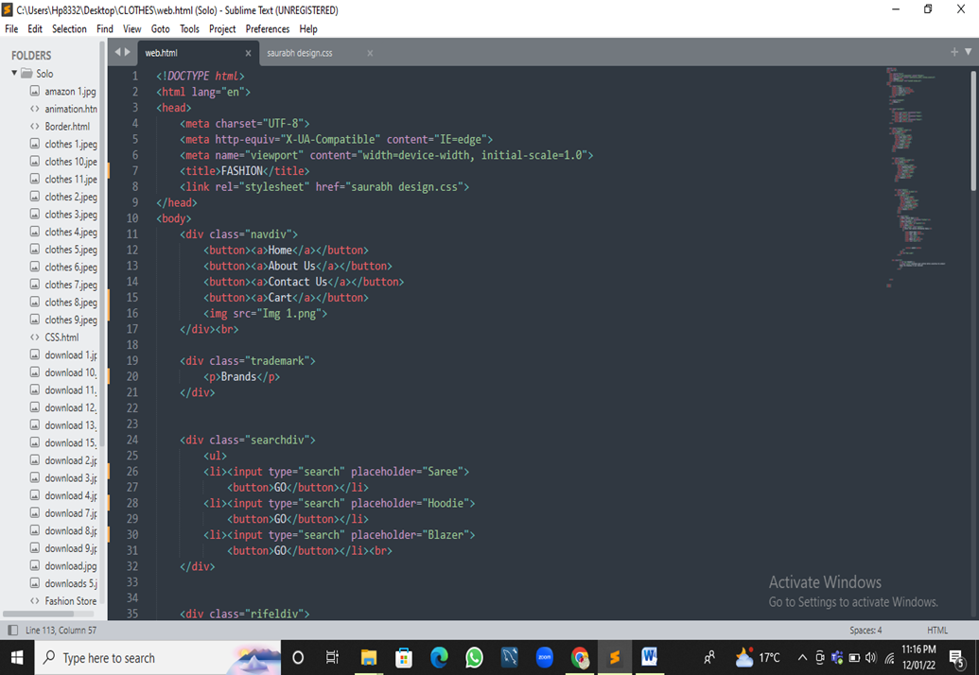


Slide 3
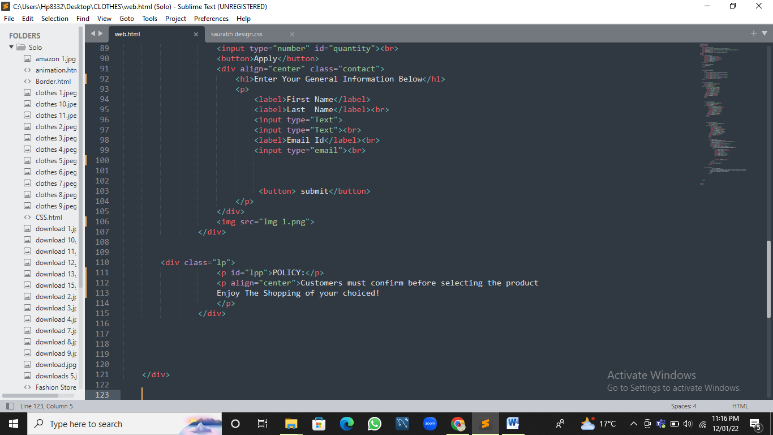

Slide 4
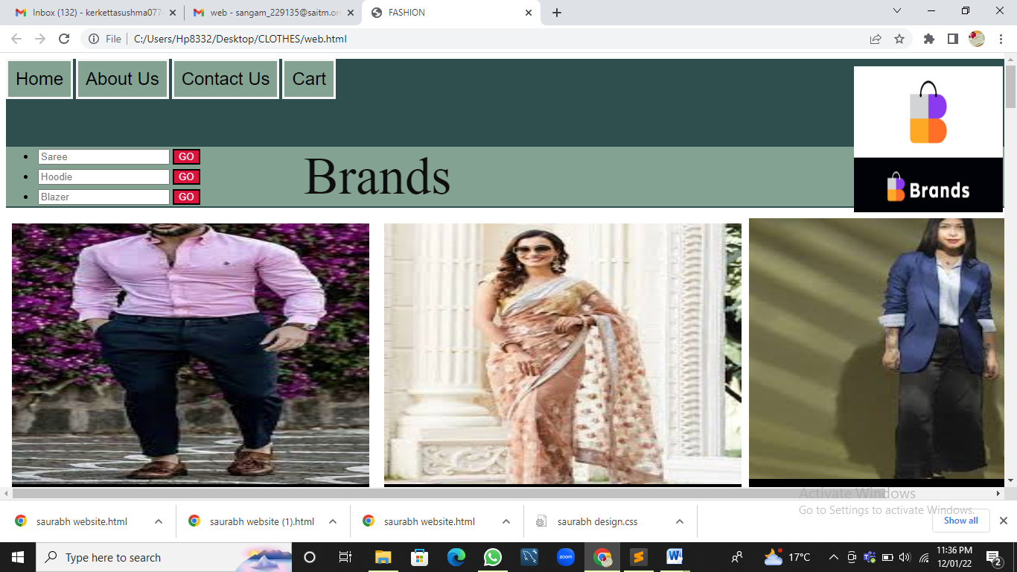
Some Pictures from my Website
Header Area

Slide 5
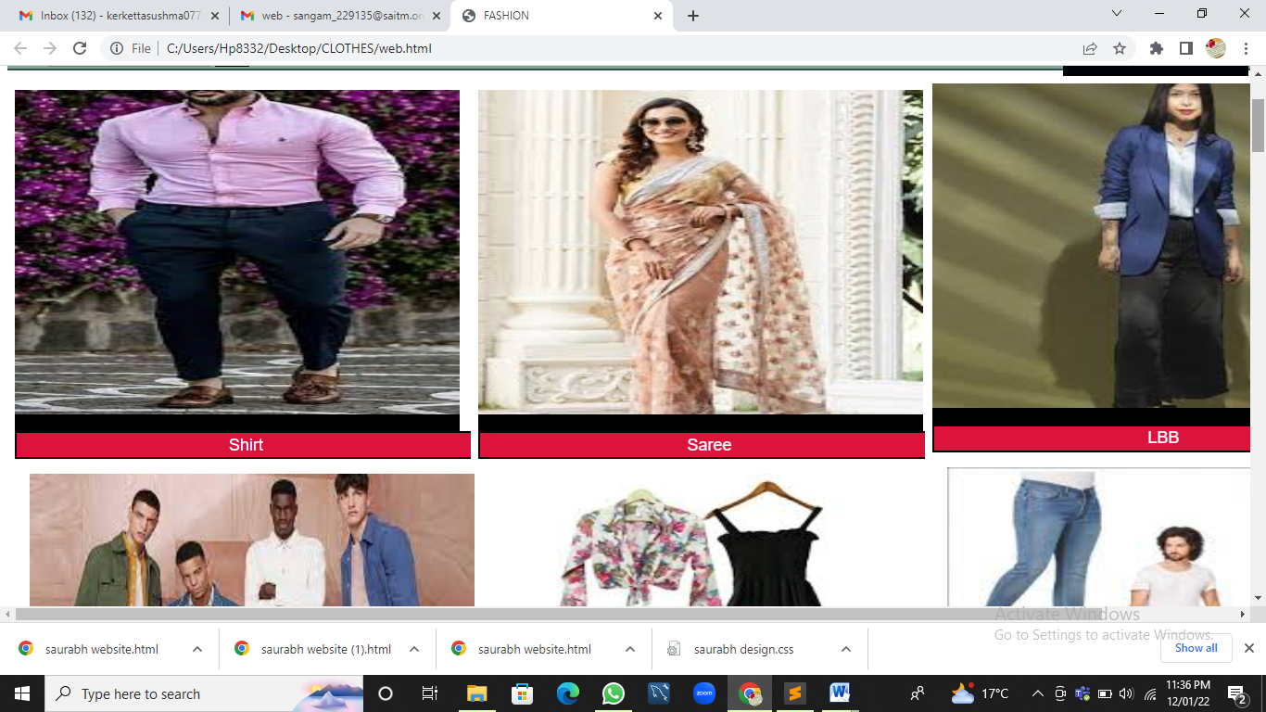
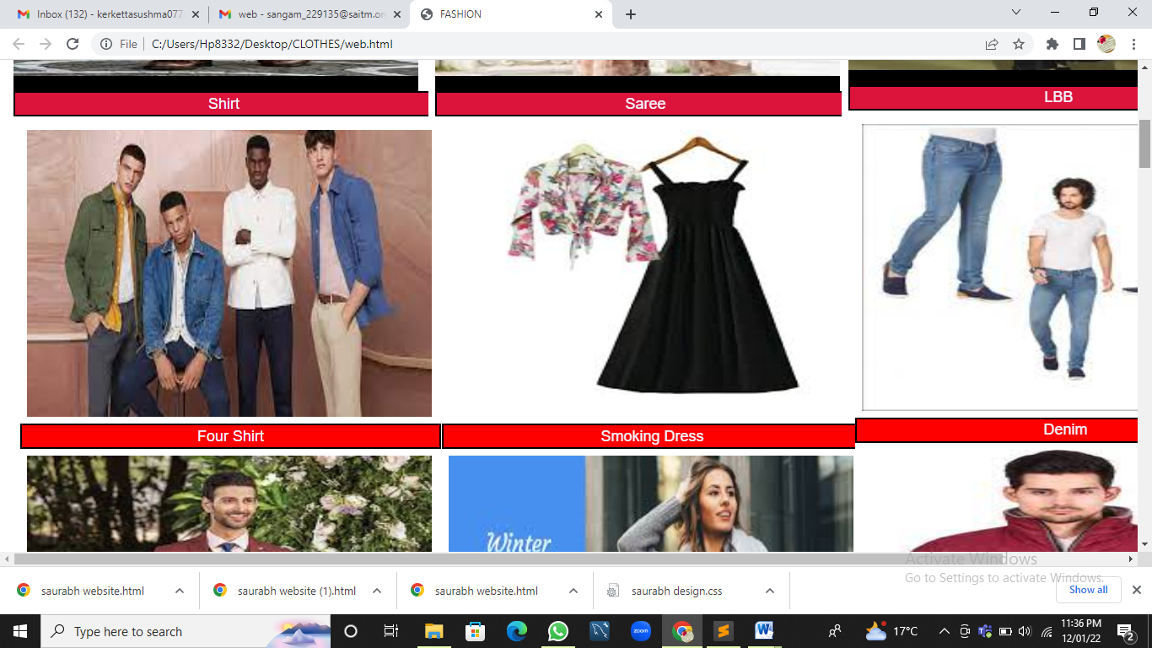
Content Area

Slide 6
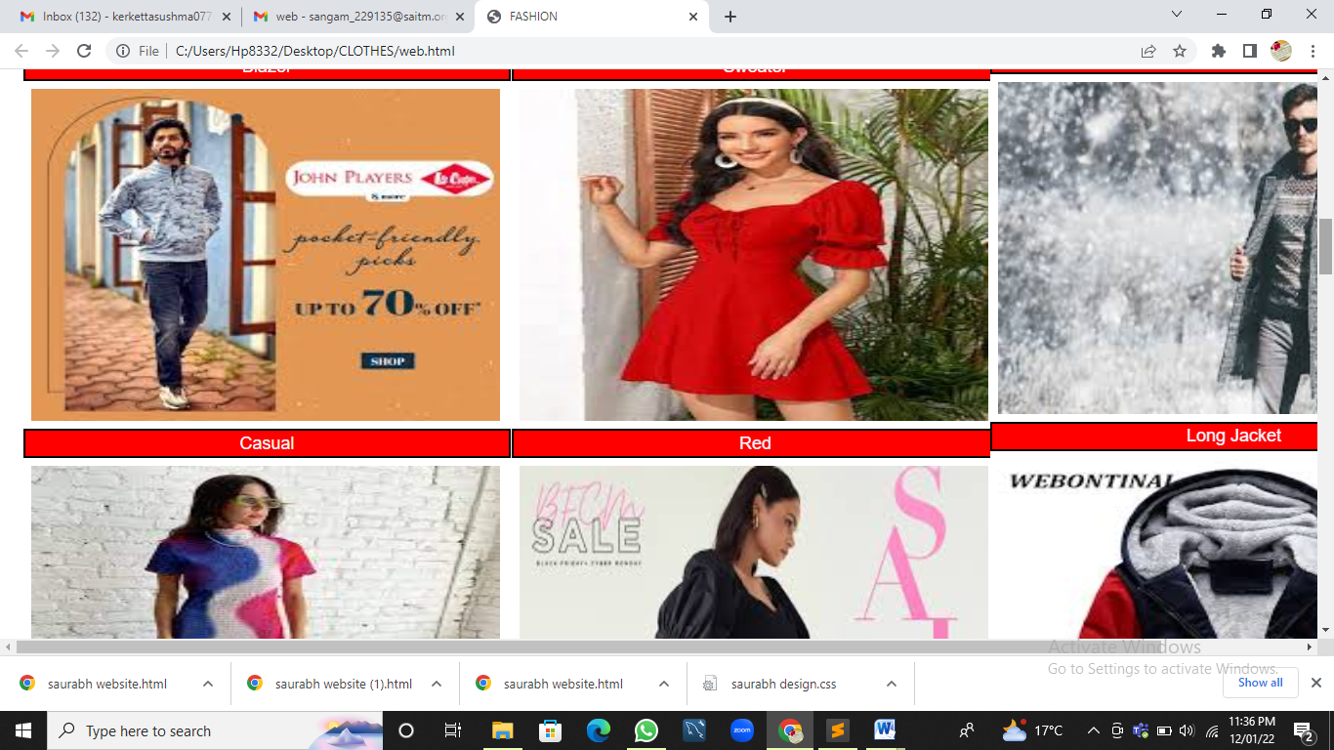

Slide 7
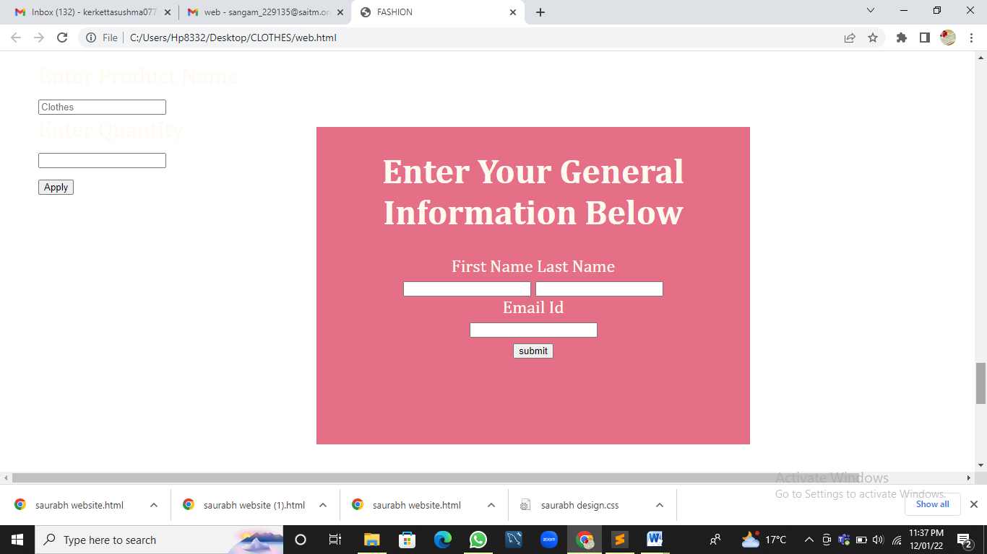

Slide 8
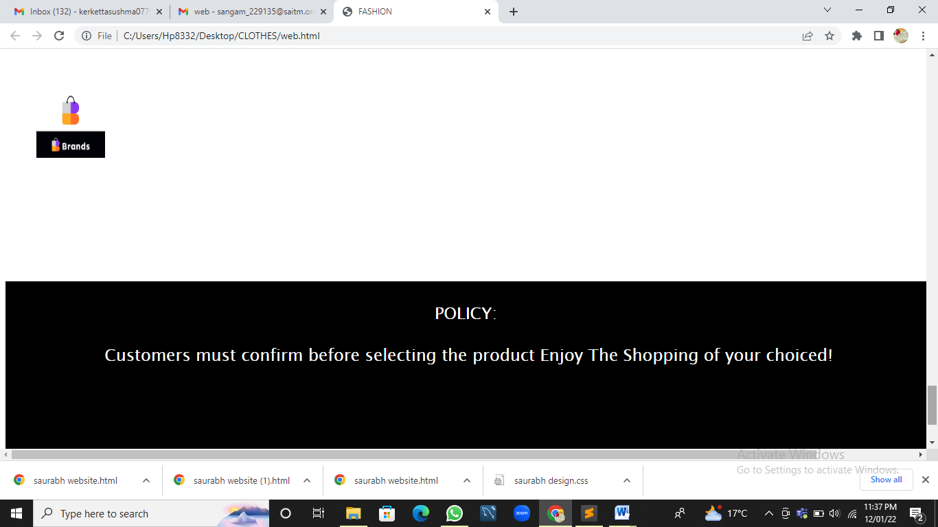

Slide 9
Bibliography
While doing this project I learn many things about HTML ANS CSS.
To do this project my friends help me and I also take help from YouTube and Google(
1. www.w3schools.com
2. www.google.co.in/imghp
3. Pait3d

